Slide 1

AID OPTIMISATION FOR FLOODS USING AERIAL IMAGES

Slide 2
Index
Team Introduction
Problem statement
Abstract
Business use case
Project outline
Data collection and processing
Algorithms used
Model comparison
Challenges faced
Our learnings
Future enhancements
Glimpse of our project

Slide 3





SAMANWITA
JAYANTH
TAKSHIL
Meet Our Team
JASBIR
SRIHAN

Slide 4
Problem statement
Develop a model using aerial imaging to optimize aid for flood rescue operations. The model will process aerial images to detect flooded areas, assess damage severity, and prioritize rescue efforts in real-time, enhancing the efficiency and effectiveness of disaster response.
Why?
We face issues of late identification of flood affected areas and can not respond in time. This model enables faster and more accurate identification of flood-affected areas, allowing rescue teams to prioritize and allocate resources effectively. By providing real-time, actionable insights, it improves the efficiency of rescue operations, reduces response times, and ultimately saves lives and minimizes damage during flood disasters.

Slide 5
Abstract
The key objectives of our project includes:
Detecting flooded residential areas
Utilize high-resolution aerial imagery to identify flooded residential areas and differentiate it with other flooded areas and water bodies.
Damage assessment
Rapid assessment of flood-affected areas using aerial images to determine the extent of damage to infrastructure and agriculture.
Long term mitigation strategies
Enhance evacuation strategies by identifying safe routes and shelter locations using aerial images.

Slide 6
Business Use Case
Insurance Companies: Use aerial images to quickly assess the extent of flood damage to properties and infrastructure. This helps in processing claims more efficiently and accurately.
Government Agencies and NGOs: Use aerial imagery to identify the most affected areas and allocate resources such as food, water, and medical supplies more effectively.
Urban Planners and Real Estate Developers: Use historical and real-time aerial images to analyze flood-prone areas and design flood-resistant infrastructure and housing.

Slide 7
Data Collection and Label Generation
Baseline Model Creation and Training
Model Comparison
Model Evaluation and Deployment
Project Outline

Slide 8
Data Used
Data Used | Aerial images of flood 1)Kaggle Dataset 2)Manual Data
Number of Images | ~1288 Images [Training(1029) and Testing(259)]
Dimension of the Images | 224*224

Slide 9
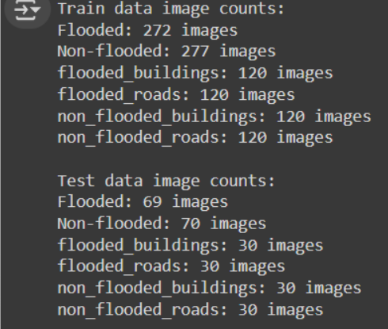
Breakdown Data Used

Slide 10
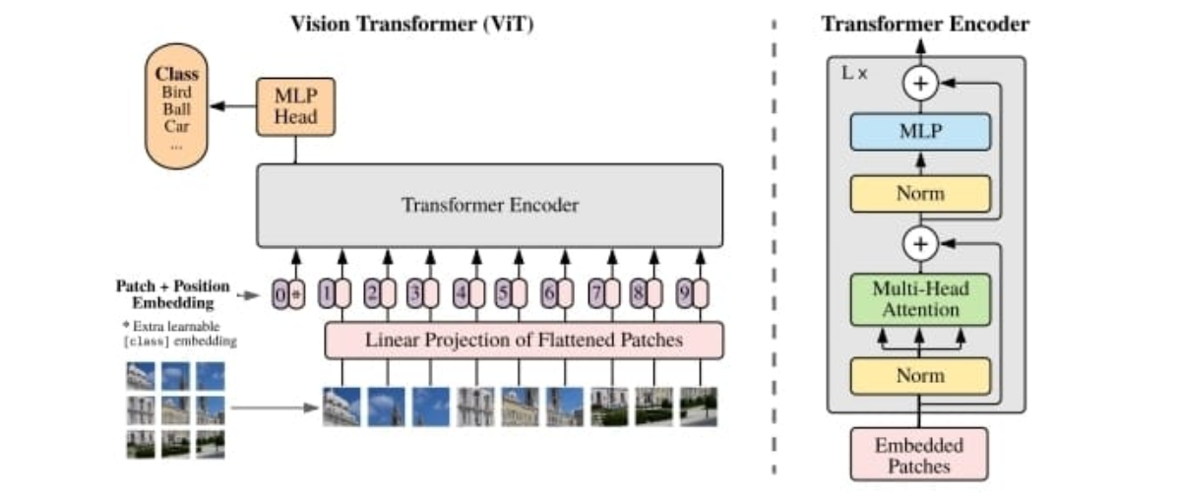
Models Used
1) CNN using UNET
2) Visual Image Transformer

Slide 11
Model Comparison
Model | Model Accuracy/Error rate
CNN using UNET | Training Accuracy -- 15 Testing Accuracy -- 10
Visual Image Transformer | Training Accuracy -- 81 Testing Accuracy -- 75

Slide 12
Challenges Faced
Data Collection and Quality:
Obtaining high-resolution, real-time aerial images during floods can be difficult due to weather conditions and accessibility.
Model Training:
Acquiring sufficient labeled data for training the machine learning models.
Real-time Processing:
Ensuring that the model processes images and provides insights quickly enough to be useful in real-time rescue operations.

Slide 13
Our Learnings
Image Processing Techniques:
Understanding how to preprocess and enhance aerial images.
Machine Learning and AI:
Implementing deep learning models, such as convolutional neural networks (CNNs), for image analysis.
Data Collection and Annotation:
Understanding the importance of high-quality, labeled datasets for training models.

Slide 14
Future Enhancements
Real-Time Processing and Alerts
Multi-Sensor Fusion
Integration with Emergency Response Systems
Automated Damage Assessment

Slide 15
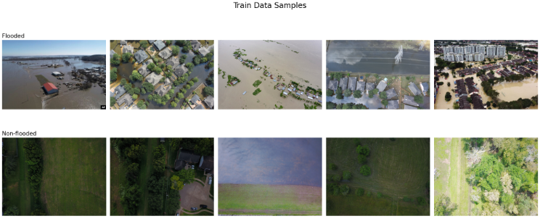
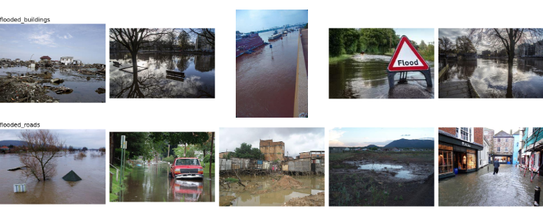
Glimpse of the Project

Slide 16
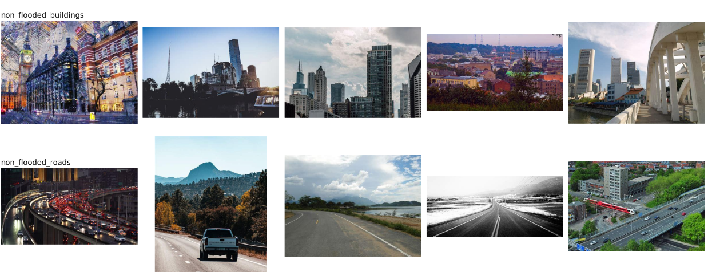
Glimpse of the Project

Slide 17
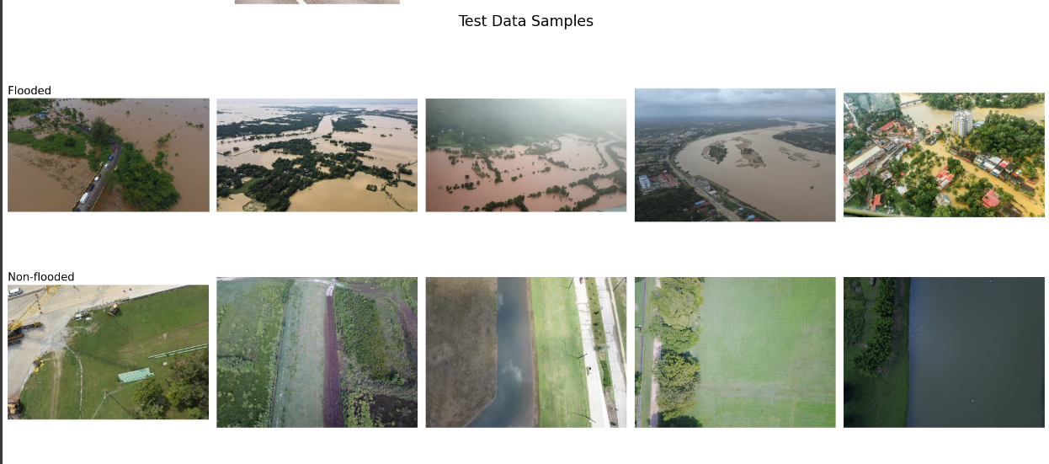
Glimpse of the Project
Visualizing sample image to understand the VIT process

Slide 18
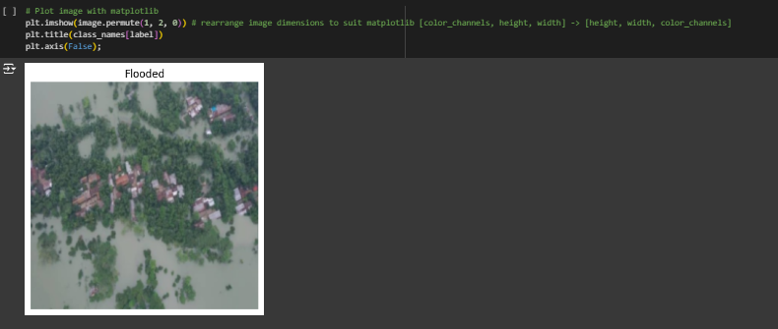
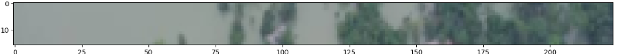
Glimpse of the Project
Top row of the patched pixels

Slide 19
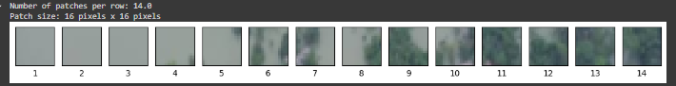
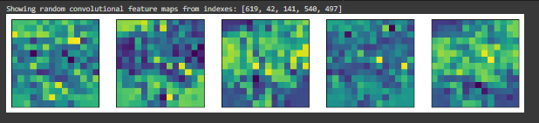
Glimpse of the Project
Converting top row of image into patches. Patch size:16*16 Image size:224*224
Convolution feature maps

Slide 20
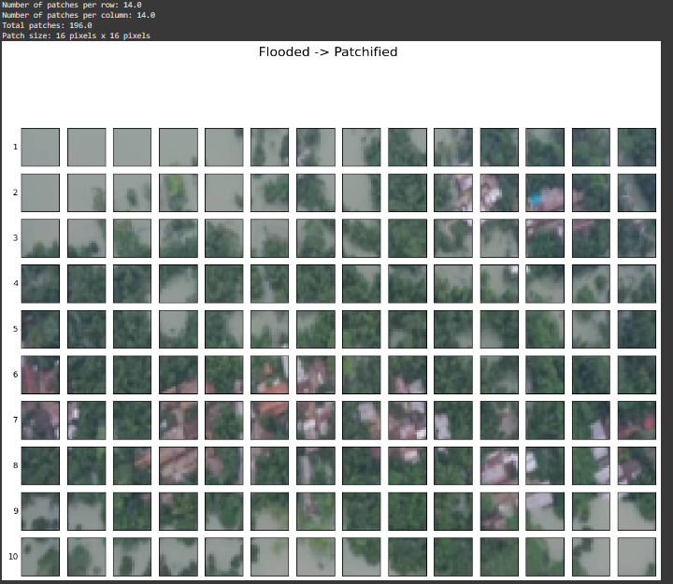
Glimpse of the Project
Sample image of flooded region in patch form

Slide 21
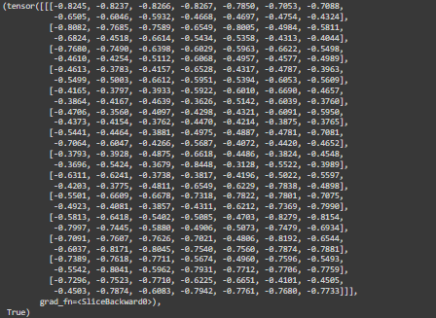
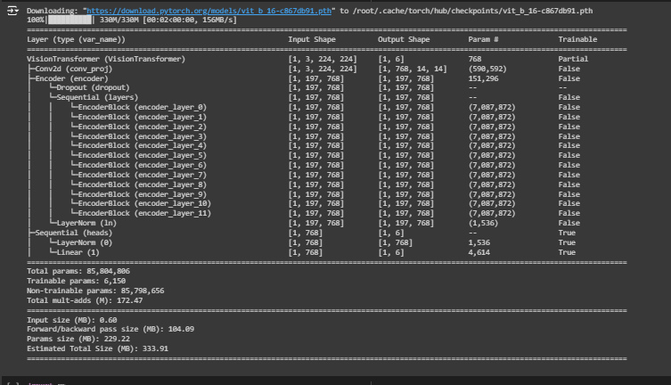
Glimpse of the Project
Sample image tensor
VIT pretrained model summary

Slide 22
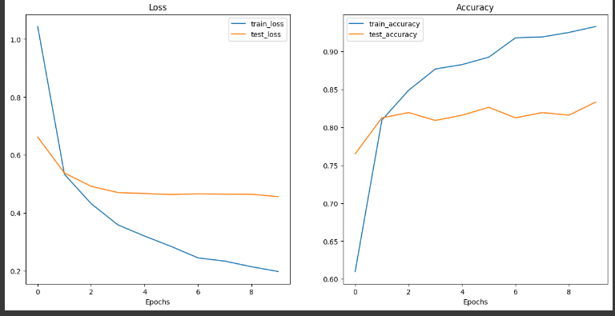
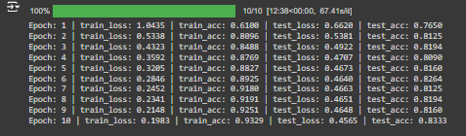
Glimpse of the Project
Pre-trained model results

Slide 23
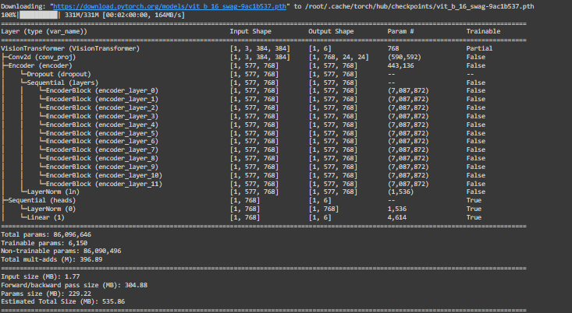
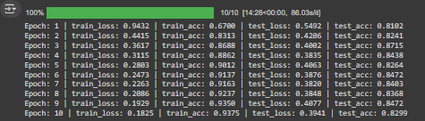
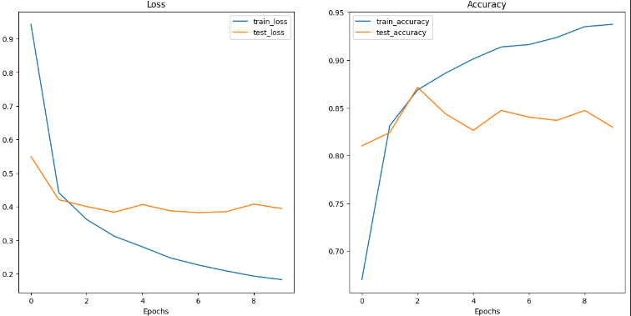
Glimpse of the Project
Feature extractor model summary
Feature extractor results

Slide 24
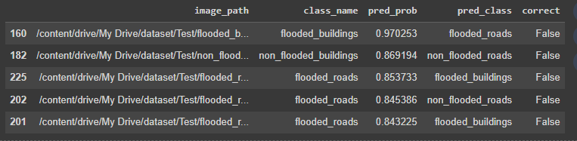
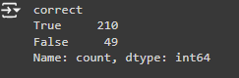
Glimpse of the Project
Top 5 most inaccurate predictions
Prediction results

Slide 25
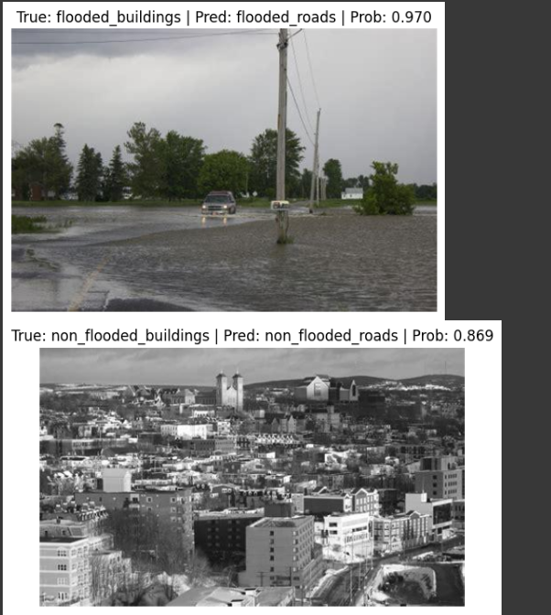
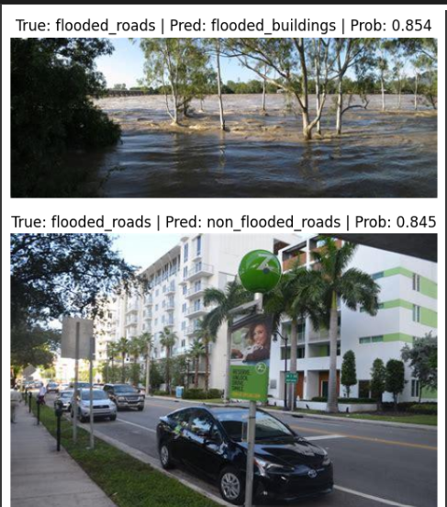
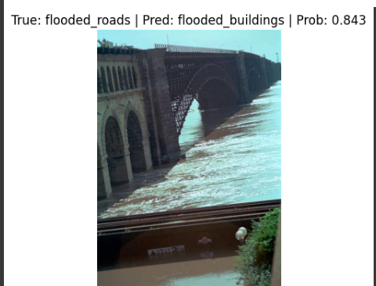
Glimpse of the Project
Evaluating incorrect predictions

Slide 26
Thank You

